Slide 1
Quality Management Regulations and Quality Management Test for Construction Work Quality Management
Kim, Ho-jin
KOREA TESTING & RESEARCH INSTITUTE

Slide 2
Table of content
Introduction
Construction Technology Promotion Act
Enforcement Decree of the Construction Technology Promotion Act
Construction Quality Management and Test
Conclusion

Slide 3
Introduction
Understanding of the Law
What is the law?
The necessity of law
The priority of application of the law
- It is an important social promise that everyone must keep in order to maintain social order
- It is necessary to maintain social order
- It is necessary to guarantee human freedom and rights
- It is a principle that the law is rated so that the higher-grade law takes precedence over the lower-grade law
Constitution
The Law
Enforcement Decree
(Presidential Decree)
Enforcement Rule
(Ministerial Ordinance)
Construction Technology Promotion Act
Enforcement Decree of the Construction Technology Promotion Act

Slide 4

Construction Technology Promotion Act
Article 1. Purpose
1. Promotion of construction technology research and development
2. Improve the level of construction technology to promote related industries
3. Appropriate implementation of construction work
4. Improve the quality of construction work and ensure safety
5. Contribute the promotion of public welfare and
the development of the national economy

Slide 5
Construction Technology Promotion Act
Article 3. Basic Plan for Construction Technology Progress
Purpose
Establish period
Content of the plan
- Promote research and development of construction technology and make efficient use of the results
- In order to promote related industries
- Every five years
- Basic objectives and directions for the promotion of construction technology
- Measures to promote and utilize construction technology
- Construction technology information management
- Supply and utilization of construction technology personnel and improvement of technical capabilities
- Fostering of construction technology research institutes
- Advancement of construction engineering industrial structure
- Matters concerning support for overseas expansion and international exchange of construction engineering, etc.
- Matters concerning support of construction engineering operators
- Matters concerning environmental management of construction works
- Matters concerning safety management and quality control of construction works
- Other important matters concerning the promotion of construction technology

Slide 6
Construction Technology Promotion Act
Article 20. Development of Construction Engineers
Purpose
Purpose of education and training for construction engineers
- For the efficient utilization and the improvement of technical capabilities of construction engineers
- In order to acquire the knowledge and skills for performing business
- Use to calculate educational and training performance grades
Technical grade | Construction engineer who works on design and construction, etc. | Construction engineer who works quality management | Construction engineer who manages construction projects
Special | Capability index of 75 or higher | Capability index of 75 or higher | Capability index of 80 or higher
Advanced | Capability index below 75 ~ 65 or higher | Capability index below 75 ~ 65 or higher | Capability index below 80 ~ 70 or higher
Intermediate | Capability index below 65 ~ 55 or higher | Capability index below 65 ~ 55 or higher | Capability index below 70 ~ 60 or higher
Basic | Capability index below 55 ~ 35 or higher | Capability index below 55 ~ 35 or higher | Capability index below 60 ~ 40 or higher

Slide 7
Construction Technology Promotion Act
Construction Quality and Safety Management
Article 55. Construction quality management
Article 56. Accounting and execution of quality management costs
Article 57. Ensuring the quality of construction materials and components
- Construction business operator and housing construction registrant
form a quality test plan for construction work
- Construction business operator and housing construction registrant conduct quality tests
and inspections in accordance with the quality management plan or quality test plan
- The contractor appropriates the construction quality management cost in the construction cost
- A person who produces, imports, or sells construction materials and components
- Construction business operator or housing construction registrant
- Manufacturer of ready mixed concrete or asphalt concrete
► Construction materials and components certified to conform to Korean industrial standards
Construction materials and components recognized by the Minister of Land, Infrastructure and Transport

Slide 8
Construction Technology Promotion Act
Construction Quality and Safety Management
Article 60. Agency for quality inspection
Person commissioned as an acting quality management agent
- National and public test institute
- Construction engineering operator
► Conducting tests and inspections for construction work quality management
- Quality inspection with materials that have been sealed or verified by the contractor or
construction engineering operator
- In the case of issuing a quality test report for materials, etc. used for construction work,
enter the quality inspection report and quality inspection contents into the integrated
construction support information system within 7 days from the date of issuance

Slide 9
Construction Technology Promotion Act
Penalty
Article 85. Penalty
Article 88. Penalty
- A person who causes serious damage to the main structure part of the facility and causes
personal injury or death shall be sentenced to life imprisonment or imprisonment for not
less than three years
- A person who endangers a person is sentenced to up to 10 years in prison or a fine of up to
100 million won
- The following persons shall be punished by imprisonment with labor for not more than
two years or a fine of not more than 20 million won
① A person who has performed construction engineering work without registration
② A construction business operator or housing construction registrant who has not
established or implemented a quality control plan or quality test plan or has not
conducted a quality test or inspection
③ A person who supplies or uses construction materials or components for
which quality is not secured
④ Those who reuse returned ready-mix concrete without quality certification

Slide 10
Enforcement Decree of the Construction Technology Promotion Act
Construction Project Management
Article 55. Implementation of construction management
- The term “Construction work prescribed by Presidential Decree" means the following construction work
① Construction with a total construction cost of more than 20 billion won
② Construction work recognized by the ordering office as necessary for the construction of bridges,
tunnels, drainage gates, railroads, subways, elevated roads, waste treatment facilities,
wastewater treatment facilities, or public sewage treatment facilities
③ Other construction works deemed necessary by the ordering office to manage construction projects
such as acting supervisory authority
- The ordering agency may not apply construction project management, such as acting supervisory authority,
to the following construction works
① Repair, restoration and maintenance of designated cultural properties and
temporary designated cultural properties
② Construction according to the Rural Development Project, Living Environment Improvement Project,
and Agricultural Industrial Complex Development Project
③ Construction carried out by local governments
④ Construction work with simple and repetitive contents prescribed by
Ordinance of the Ministry of Land, Infrastructure and Transport
⑤ Military Special Works, Correctional Facilities Works and State Confidential Construction Works
⑥ Broadcasting Facilities Corporation with Specialized Technology
⑦ Construction of nuclear reactors, radiation generators, related facilities, nuclear fuel cycle facilities,
and disposal facilities

Slide 11
Enforcement Decree of the Construction Technology Promotion Act
Construction Project Management
Article 59. Business scope and contents of construction project management
- Categorization of business scope
① Pre-design stage
② Basic design stage
③ Implementation design stage
④ Procurement stage
⑤ Construction stage
⑥ Post-construction stage
- Step-by-step business content
① General business management such as planning, operation, and coordination of construction works
② Construction contract management ③ Construction cost management ④ Construction work process management ⑤ Construction quality management ⑥ Safety management of construction works ⑦ Environmental management of construction works ⑧ Construction project information management ⑨ Management of risk factors related to construction cost, process, quality, safety, etc.

Slide 12
Enforcement Decree of the Construction Technology Promotion Act
Construction Quality and Safety Management
Article 89. Construction subject to quality management plan
- Construction works that require a quality management plan are as follows
① Construction work subject to construction project management, with a total construction cost of
more than 50 billion won.
② Construction of multi-use buildings with a total floor area of 30,000 square meters or more
③ Construction work that requires a quality management plan to be established in the construction contract
- Construction work requiring additional quality test plans
① Civil engineering works with a total construction cost of more than 500 million won
② Construction of buildings with a floor area of 660 square meters or more
③ Specialized construction with a total construction cost of more than 200 million won

Slide 13
Enforcement Decree of the Construction Technology Promotion Act
Construction Quality and Safety Management
Article 91. Quality test and inspection
- Quality tests and inspections shall be conducted in accordance with the Korean Industrial Standards,
Construction Standards, or the Construction Work Quality Inspection Standards determined and
announced by the Minister of Land, Infrastructure and Transport
- The following materials may not be inspected for quality
① Materials for which test reports are submitted by national and public testing agencies or
construction technology service providers acting on behalf of quality inspections
② Korean Industrial Standards Certified Products
③ [Industrial Safety and Health Act] Products certified for safety in accordance with the regulations.
④ Materials that have been inspected or certified for quality in accordance with relevant laws and
regulations such as the [Housing Act]

Slide 14
Enforcement Decree of the Construction Technology Promotion Act
Construction Quality and Safety Management
Article 95. Scope of construction materials and components
- The term “Construction materials and members prescribed by Presidential Decree" means construction
materials and members falling under any of the following
① Ready mixed concrete
② Asphalt concrete
③ Sea sand
④ Crushed aggregate
⑤ Reinforced steel, H-shaped steel, structural eye-shaped steel, construction steel sheet with
a thickness of 6 millimeters or more, structural steel pipes, high tension bolts, PC steel wires,
PC steel wires, and PC steel rods
⑥ Recycled aggregate
- The term “Construction prescribed by Presidential Decree" means any of the following construction works
① In the case where a construction business operator or housing construction registrant intends to use
construction materials or components under each subparagraph of paragraph (1)
② When a manufacturer of ready mixed concrete or asphalt concrete intends to use construction materials
such as sea sand, crushed aggregates, rebars, and H-shaped steel in paragraph (1) above

Slide 15
Enforcement Decree of the Construction Technology Promotion Act
Construction Quality and Safety Management
Article 95. Scope of construction materials and components
- Construction materials and components shall be the following construction materials and components
① As a result of the quality inspection requested by the construction business operator and housing
construction registrant and manufacturers of ready-mixed concrete or asphalt concrete to
the national testing agency acting on behalf of the quality inspection, construction materials
that are above the standard prescribed by the Korean Industrial Standards or meet the specifications
② As a result of the quality inspection conducted by the construction project management service provider
or construction supervisor of the relevant construction project, construction materials and components
that are above the standard set by the Korean Industrial Standard or suitable for the specifications
of the construction
③ Recycled aggregate that conforms to the quality standards under
the [Construction Waste Recycling Promotion Act]
④ Aggregate that meets the quality standards according to [Aggregate Collection Method]

Slide 16
Quality Management of Construction Work
Quality management
Definition of quality management
Quality management by introducing quality management techniques at all stages of planning, investigation, design, construction, etc.
Quality management activities for construction performance conducted through inspection and inspection of materials and construction conditions used at construction sites
A generic term for all means and systems to economically produce products of quality that meet the needs of the contractor
Conduct inspections and tests at every stage of the process, identify problems early, and guide them to proceed with the construction as intended to ensure reliability of the construction work
Purpose of quality management
Purpose of quality test
Test and investigate the characteristics of a sample or specimen of a material or product for quality control and generate data
Objectively evaluating the quality of construction to induce sound construction, such as prevention of poor construction
Contractor
Quality
Constructor
Manufacturer

Slide 17
Quality Management of Construction Work
Characteristics of Quality Management in Construction Projects
Specificity of Construction Production
- The one-piece order industry
- Depending on the content and conditions
Lack of awareness of quality management
- Stereotypes that only personnel should be managed
- Conventions that follow experience, intuition, and guts rather than data
A variety of environment
- Different conditions such as location for each project
- Diversity of social and environmental quality characteristics and management
Quality evaluation criteria unclear
- Establishing a quality-cost relationship is not specific
- Customer requirements vary

Slide 18
Quality Management of Construction Work
Time and Cost for Inappropriate Measures for Construction Projects
Engineering stage : Inspection stage : Customer use stage = 1 : 10 : 100
Research
Design
construction
customer
Difficult to detect or predict defects
but
easy to fix
Easy to detect defects
but
costly to fix
Prevention Cost
1
Correction Cost
10
Failure Cost
100

Slide 19
Quality Management of Construction Work
Quality Test Plan
- Construction business operator and housing construction registrant must establish
a quality test plan and obtain approval from the contractor before construction
- Before submitting the plan to the contractor, it shall be reviewed and confirmed by
the construction supervisor or the construction project management engineer
① Plan establishment
- An contractor other than the ordering agency shall submit a quality plan to the head of the
licensing and licensing agency in advance
- The submitted ordering office or the head of the licensing agency shall examine
the contents of the plan and notify the result in writing (appropriate, inappropriate, etc.) to
the construction business operator and housing construction registrant
② Submission
- The contractor shall issue an approval letter to the construction business operator and
housing construction registrant if the contents of the quality test plan are judged appropriate
and the main building department appropriate
③ Approval
- The person placing an order shall check whether the quality control work is
properly carried out in accordance with the quality test plan (at least once a year)
④ Confirmation
- If it is deemed necessary to correct it as a result of confirmation, the construction business
operator and housing construction registrant shall correct it without delay and notify
the contractor of the result.
⑤ Completion
(Quality test plan implementation procedure)

Slide 20
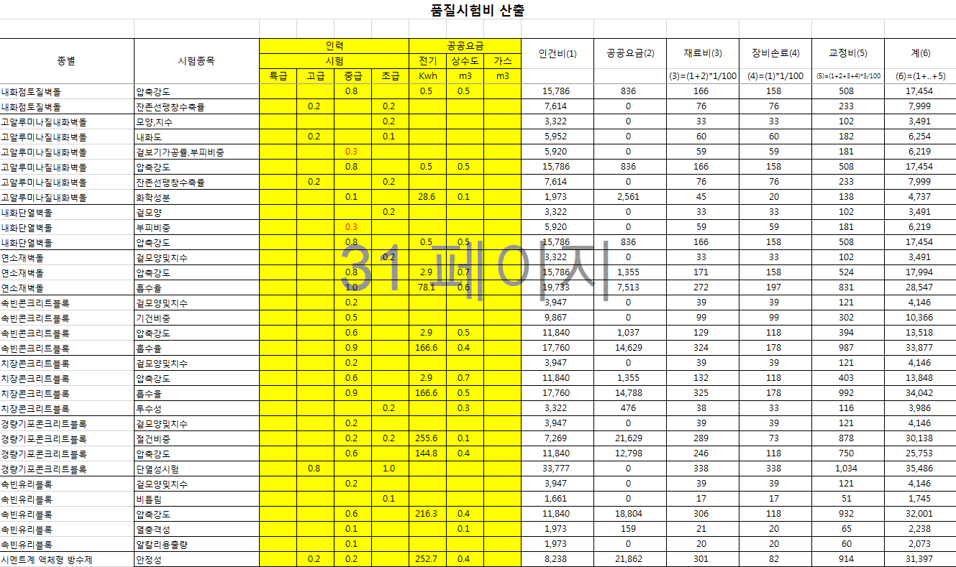
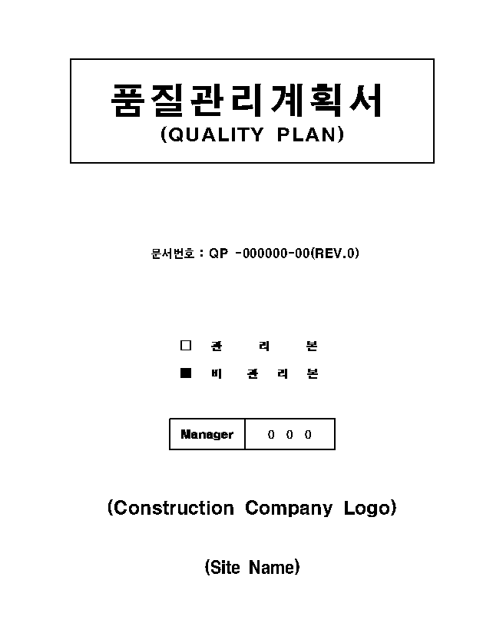
Quality Management of Construction Work

Slide 21
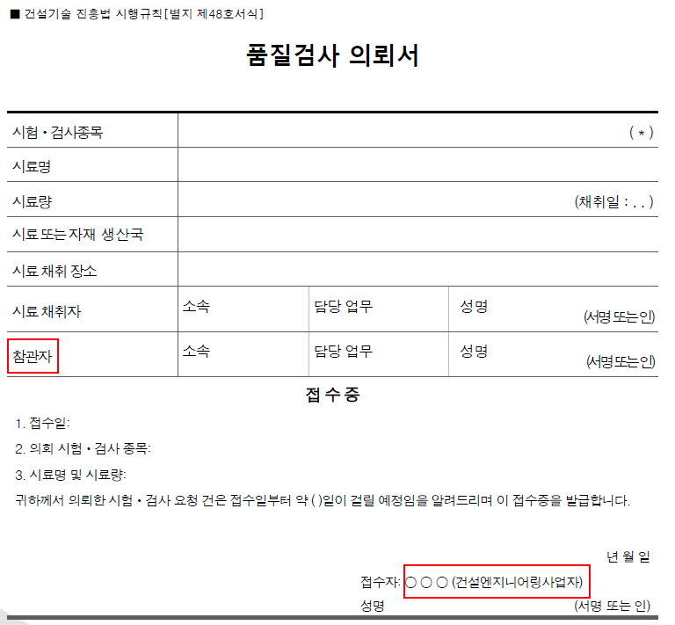
Quality Management of Construction Work
Quality Test Processing Procedure
Sampling
(Field)
Registration
(Testing Institute)
Test requester
(Quality Manager)
Conducting the test
(Testing Institute)
Notification of results
(Computerized System)

Slide 22
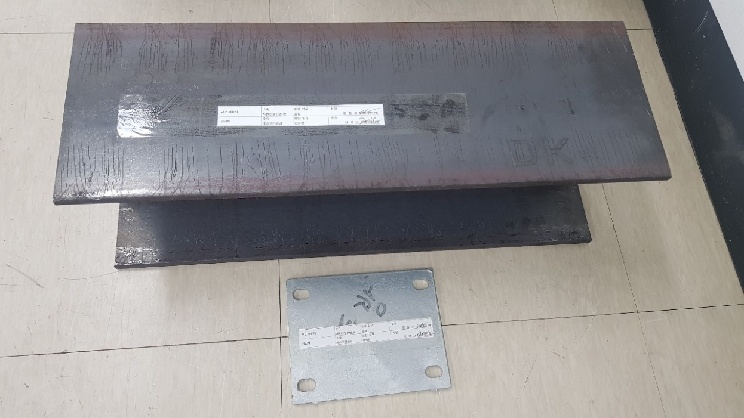
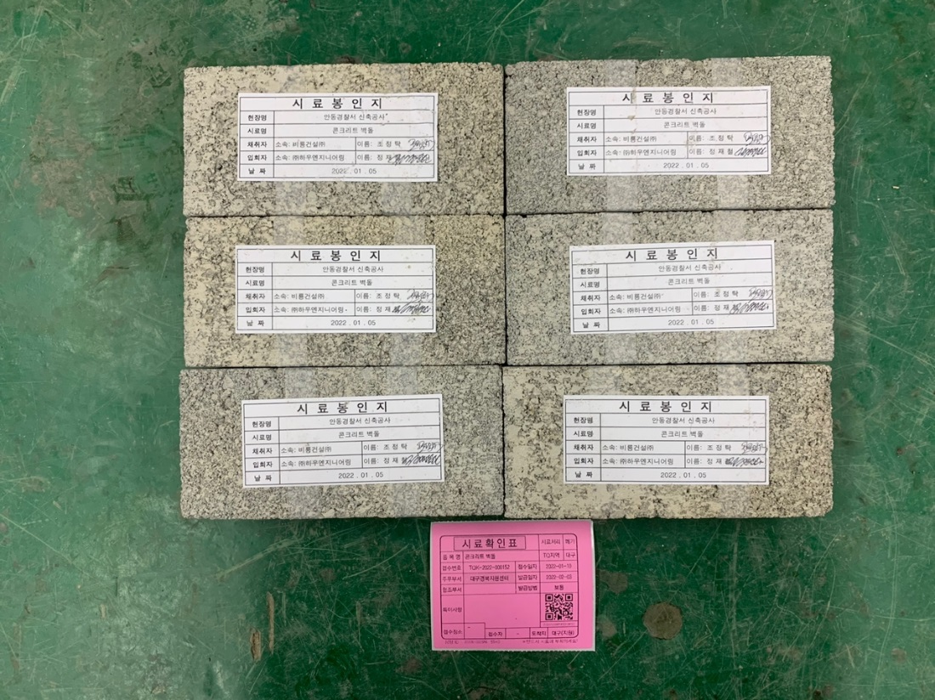
Quality Management of Construction Work
Sealed Sample for Quality Test

Slide 23
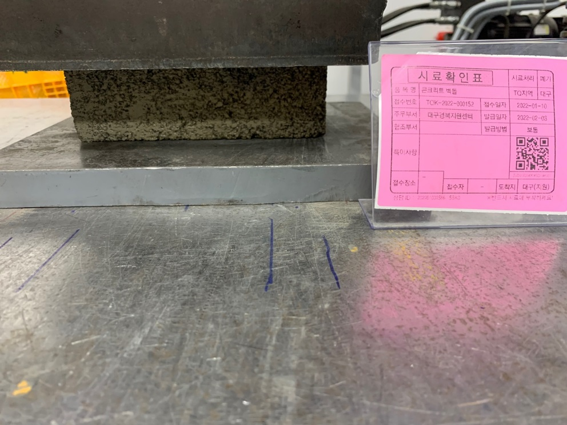
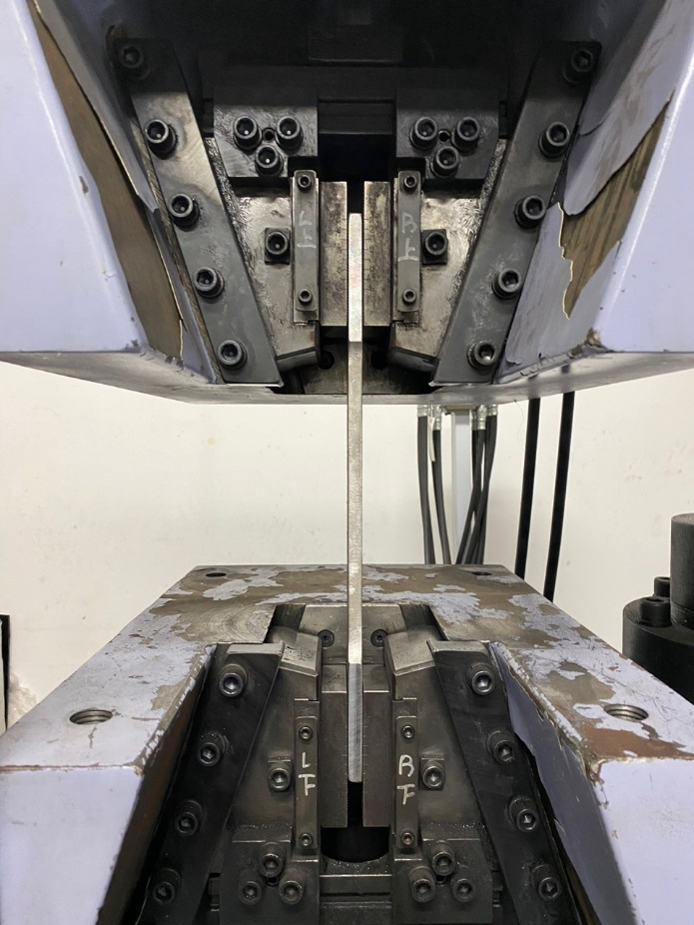
Quality Management of Construction Work
Quality Test

Slide 24
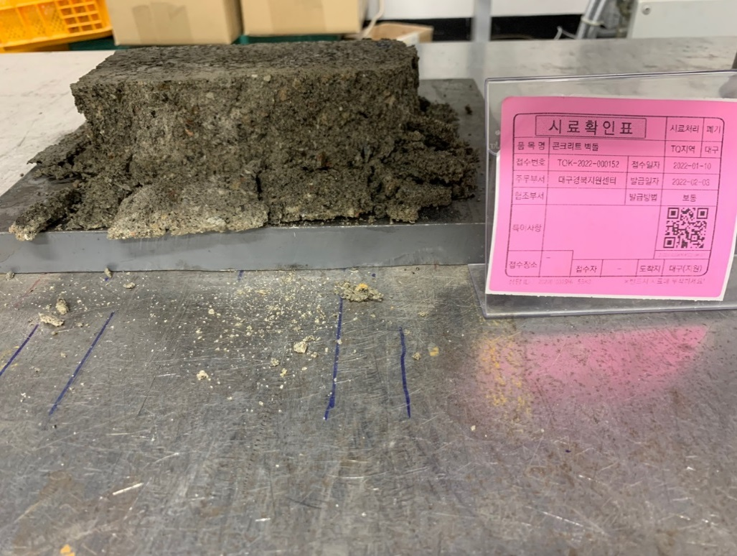
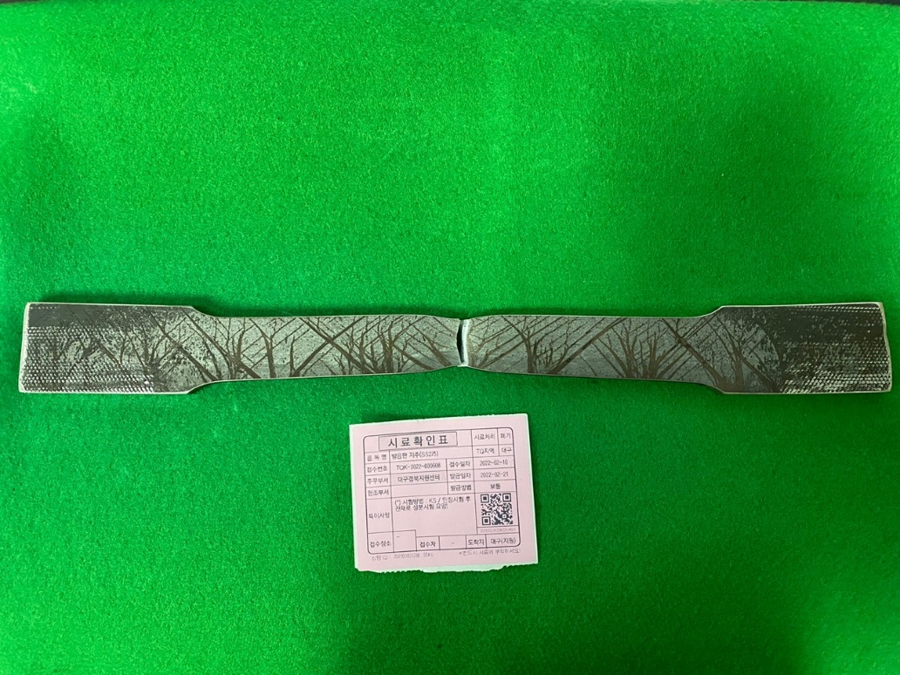
Quality Management of Construction Work
Sample After Test

Slide 25
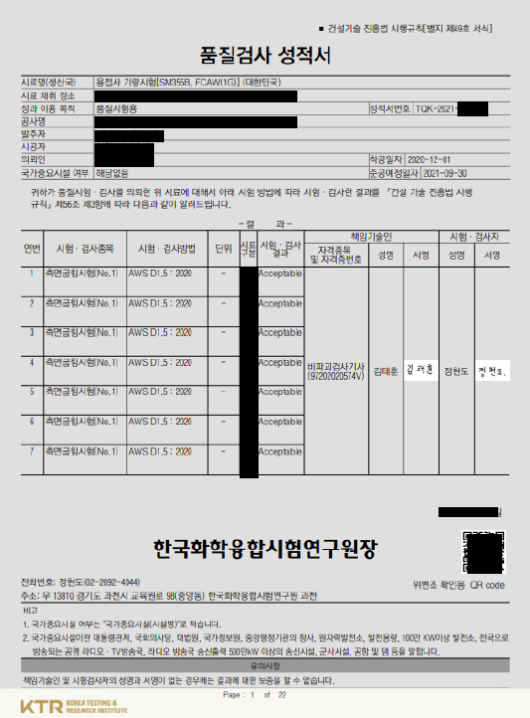
Quality Management of Construction Work
Test Report

Slide 26
Quality Management of Construction Work
Nondestructive Test
(Ultrasonic Test)
(Computed Radiograhpy)
(Magnetic particle detection test)
(Penetration Test)

Slide 27
Quality Management of Construction Work
Fire Resistance Test
(Fire resistance test equipment for horizontal members)
(Fire resistance test equipment for vertical members)
(Smokeproof test equipment)

Slide 28
Quality Management of Construction Work
Fire Resistance Test(Vertical Members)

Slide 29
Quality Management of Construction Work
Fire Resistance Test(Vertical Members)

Slide 30
Quality Management of Construction Work
Fire Resistance Test(Horizontal Members)

Slide 31
Conclusion
Promotion of Public Welfare and
the Development of the National Economy
Eye Level
of
Consumers
Research
and
Development
Quality
Test
Promotion of
Construction Technology
Research and Development
Quality
Management
Quality Management
of Construction Work
Professional
Manpower
Construction
Technology
Compliance
With the law
Construction Technology Promotion Act

Slide 32
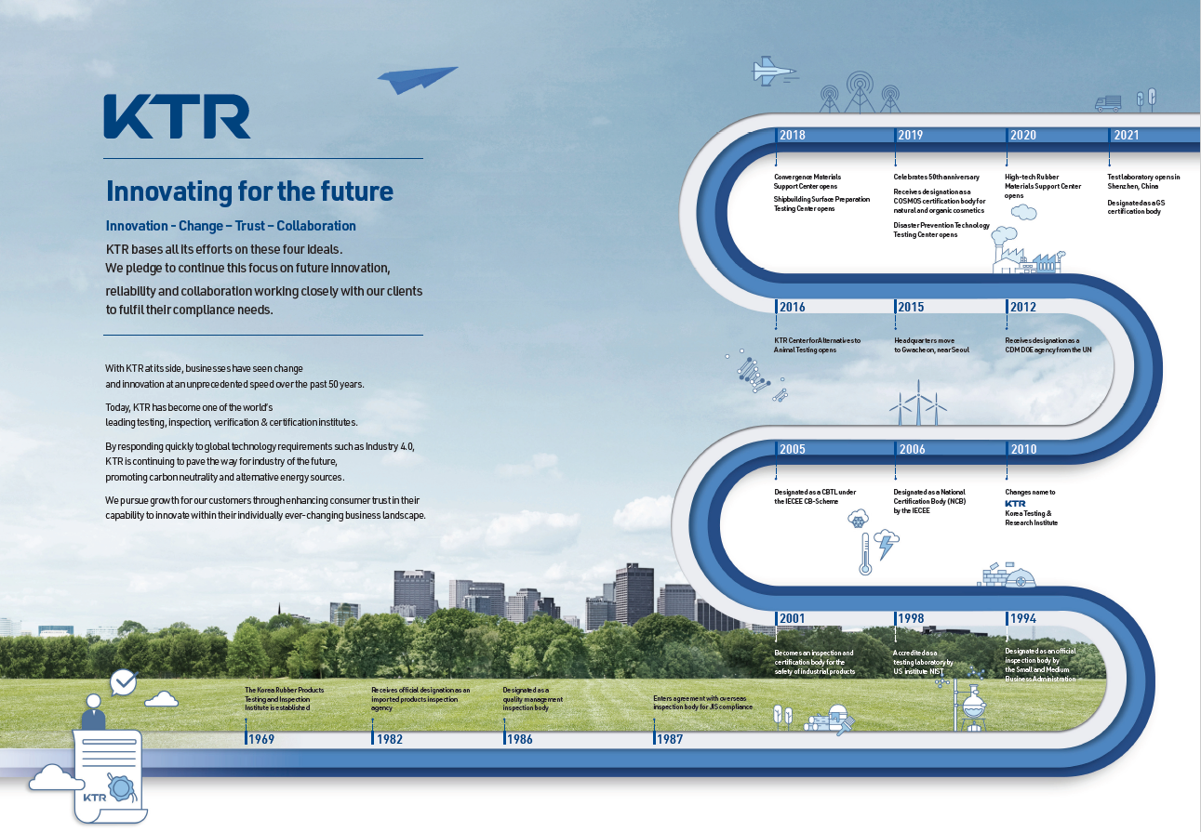
KTR

Slide 33
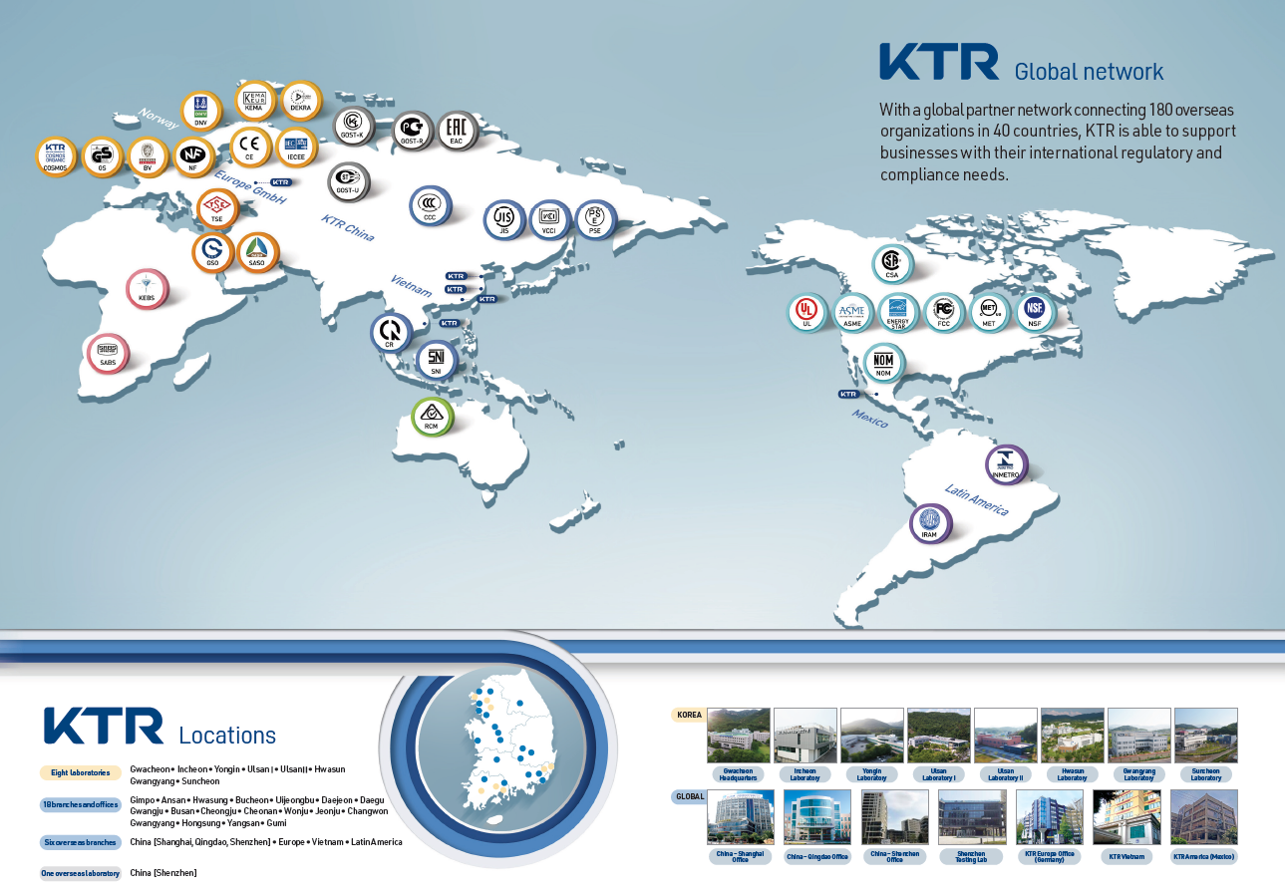
KTR

Slide 34

Thank YOU!

